Slide 1
Project 3
Significant Volcanic Eruptions Dashboard
Presented by: Liam, Gulcan, Minali, Irina

Slide 2
Introduction
“The goal of this project was to explore significant volcanic eruptions worldwide using data from "The Significant Volcanic Eruption Database." By analyzing and visualizing this data, we aim to gain insights into the distribution, characteristics, and impact of significant volcanic eruptions across different regions.”

Slide 3








Methodology
Hypothesis
Data collection
Analysing
Developing the application
Data visualisation
Creating and deploying the dashboard
?

Slide 4


Our hypothesis
Correlation between significant eruptions and geographical features
Investigating the relationships between these factors

Slide 5

Data Collection
Data Source: https://public.opendatasoft.com./explore/dataset/significant-volcanic-eruption-database
License : U.S. Government Work
Modified : June 18, 2019 9:54 PM
Publisher : National Centers for Environmental Information
Reference : https://www.ngdc.noaa.gov/nndc/struts/form?t=101650&s=1&d=1
Attributions: National Geophysical Data Center / World Data Service (NGDC/WDS): Significant Earthquake Database. National Geophysical Data Center

Slide 6
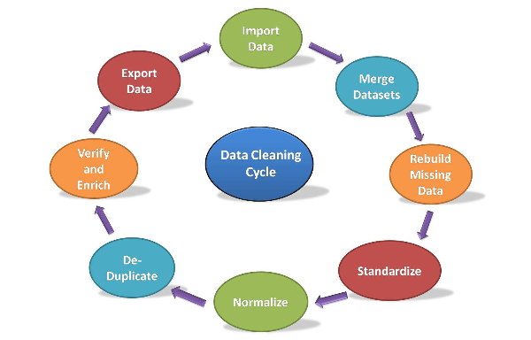
Cleaning Data
Cleaning data using Python and Excel involves several steps. Here is a detailed breakdown of the process followed:
Import the libraries like pandas,numpy and pathlib
Load the data from Excel.
Explore the data.
Handle missing values.
Rename columns.
Export the cleaned data back to Excel
Save the cleaned Data.
Notes:
Import the necessary libraries like pandas,numpy and pathlib
Load the data from Excel: Use Pandas to read the Excel file and load it into a DataFrame.
Explore the data: Perform initial data exploration to understand the structure and content of the dataset.
Display the first few rows,check column names and data type.
Handle missing values: Deal with missing data, which can include dropping rows, filling missing values with specific values(like 0 for Numeric Values and True/False for Boolean type ), or interpolating missing values.
Rename columns: Rename columns to provide more descriptive names.
Export the cleaned data back to Excel
Save the cleaned Data Frame to a new Excel file volcano_data.csv.

Slide 7
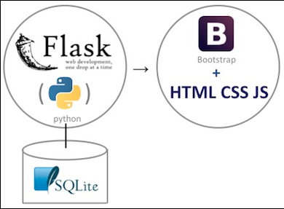
Flask Application
Flask is a lightweight web framework written in Python that allows you to build web applications easily and quickly.
Components:
Routes: In Flask, you define routes using the @app.route decorator.
View functions are Python functions that are associated with specific routes.
Templates: Flask uses Jinja2, a powerful and flexible templating engine, to generate dynamic HTML content.
Serve static files, such as CSS, JavaScript, and images.
Notes:
Routes: In Flask, you define routes using the @app.route decorator.
View functions are Python functions that are associated with specific routes. They handle incoming requests, process data, and generate responses. The return value of a view function in this project is an HTML content.
Templates: Flask uses Jinja2, a powerful and flexible templating engine, to generate dynamic HTML content.In this project,render_template function is used to render templates.
Later which allows you to serve static files, such as CSS, JavaScript, and images

Slide 8
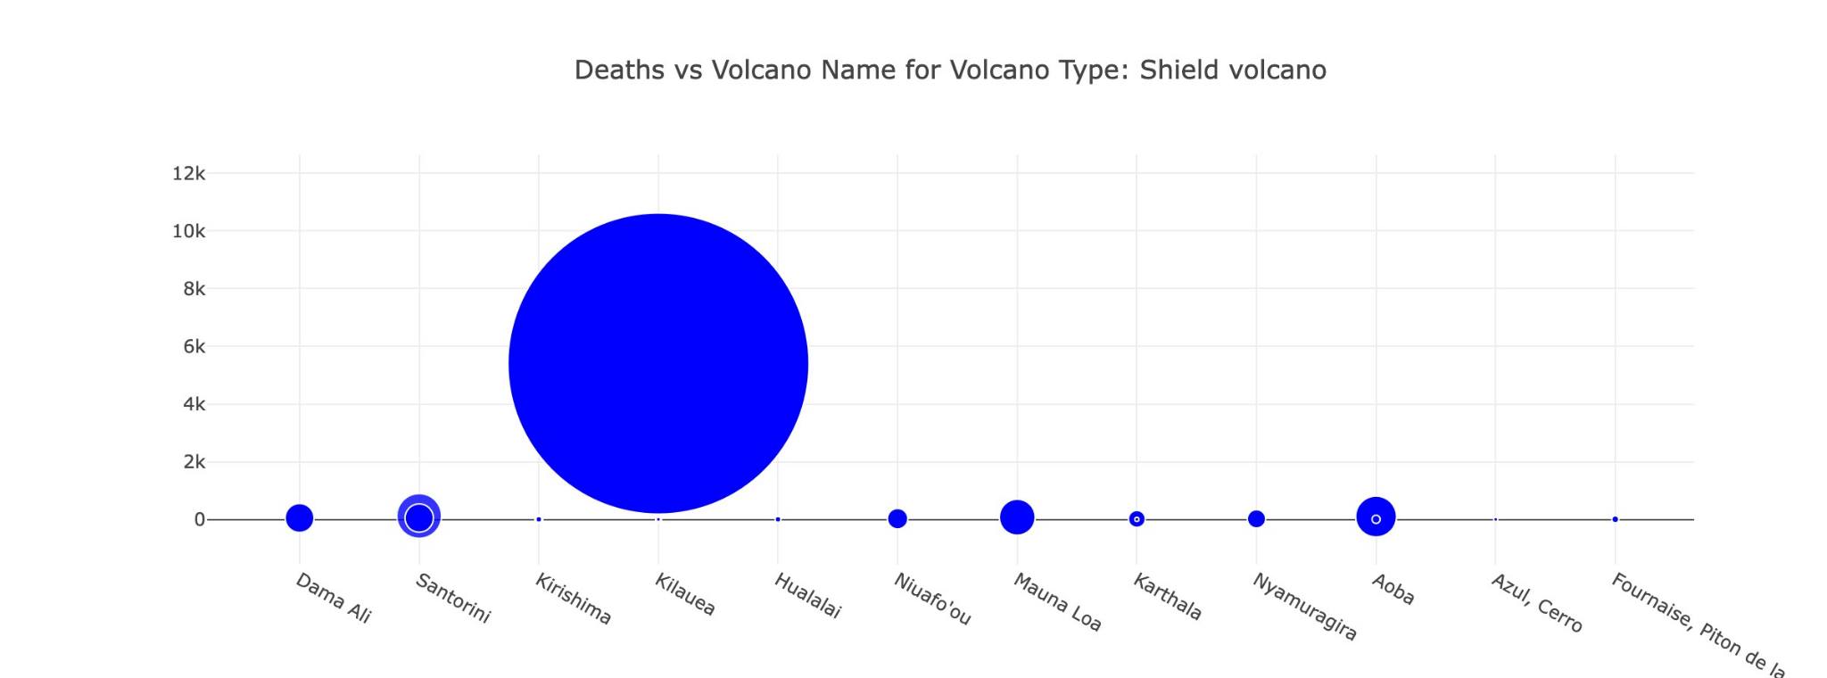
Charts and visualisation - 1
1.This bubble chart visualizes
the relationship between
deaths and volcano names
based on their volcano type.
2.The chart allows to explore
the impact of different
volcano types on fatalities.

Slide 9
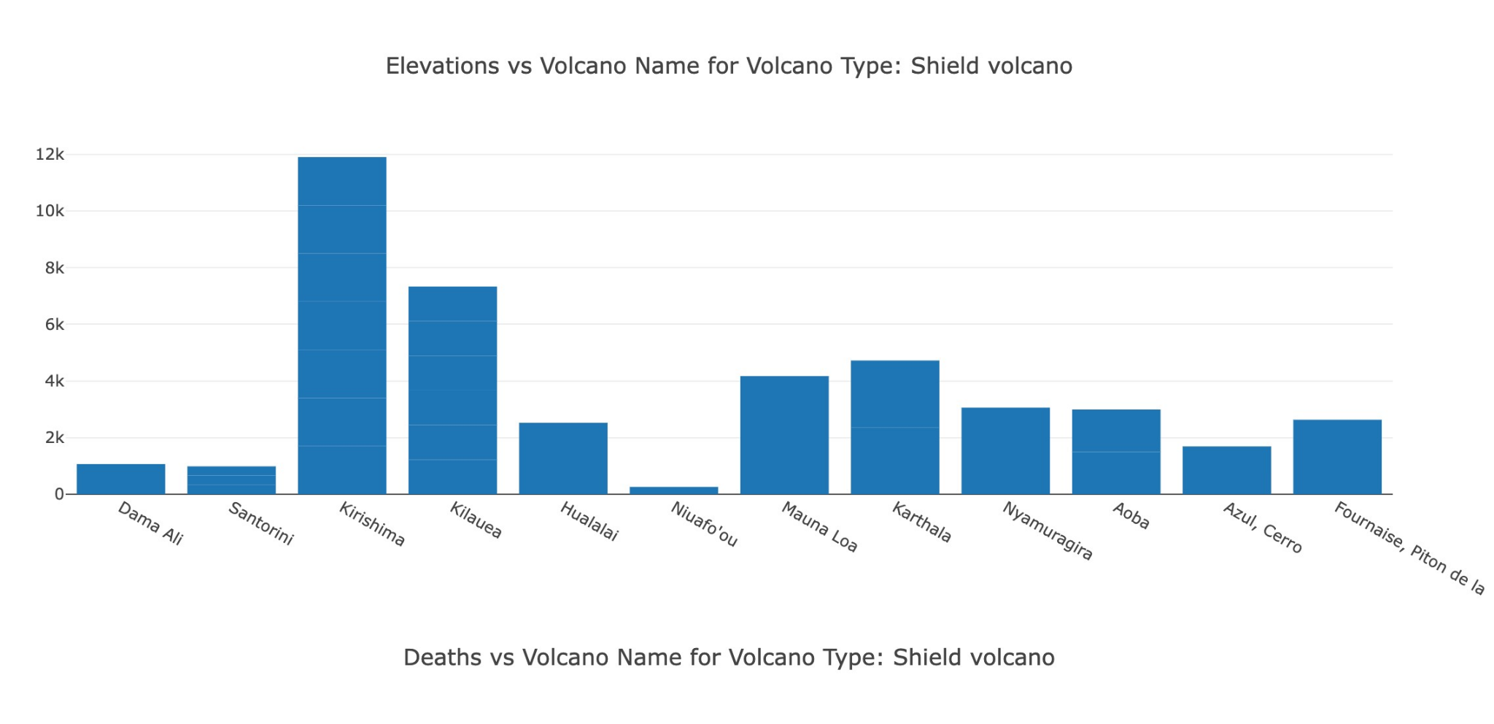
Charts and visualisation - 2
1.This bar chart illustrates
the elevations of volcanoes
based on their volcano type.
2.Each bar in the chart
represents a volcano,
the length of the bars
indicates the relative
elevations of the volcanoes.

Slide 10
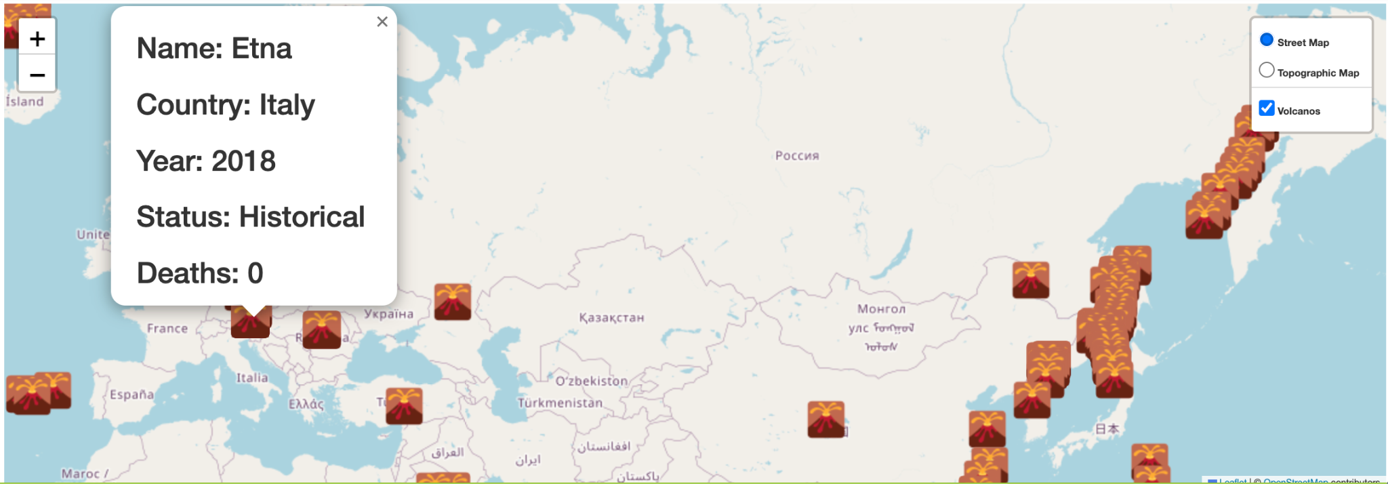
Mapping
Map has a global listing of over 500 significant eruptions which includes information on the coordinates , names of volcano, countries, years of the eruption, elevation, types of volcano, total deaths.
Name : Volcano name
Country: Location
Year: Date of eruptions
Status: Categories
Deaths: Total number of deaths
Markers reflect the volcano location with volcano status, year of eruptions, total deaths number.

Slide 11
Conclusion & demo
Our findings suggest that:
The caldera and stratovolcano types contribute to the most fatalities.
These types of volcanoes are also found closer to the equator
Notes:
Conclusion:
Based on the analysis of the data and the visualizations of significant volcanic eruptions during the historical period of time, several conclusions can be drawn.
This project's visualizations and analysis of the Significant Volcanic Eruption Database have provided valuable insights into the spatial correlation between eruptions, the impact of volcano types on fatalities, and the variations in volcanic landforms. These findings contribute to a better understanding of volcanic activity during the historical period and can aid in future volcanic hazard assessment and mitigation efforts.
The relationship between deaths and volcano names based on their volcano type provides valuable insights into the impact of different volcano types on fatalities. By analyzing this data, it is possible to identify that , the caldera and stratovolcano types emerge as significant contributors to the highest number of fatalities. This finding underscores the need for increased awareness and preparedness in regions with these specific volcano types.

